Slide 1


Board Meeting
Group - 5

Slide 2

Executive Summary
Strategic Goal: Sustainability focused, break-even by Q4 2025 and profitable by 2026
Recommendation: B2B-led Hybrid Model
Why Hybrid Works:
Combines profit engine (B2B)
Protects mission & trust (B2C)
Balances all stakeholder interests
Outcome: Profit with Purpose

Slide 3
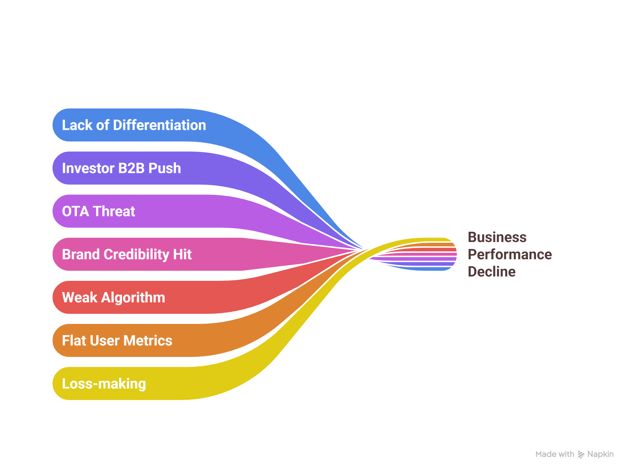
The Challenge We Must Solve

Slide 4
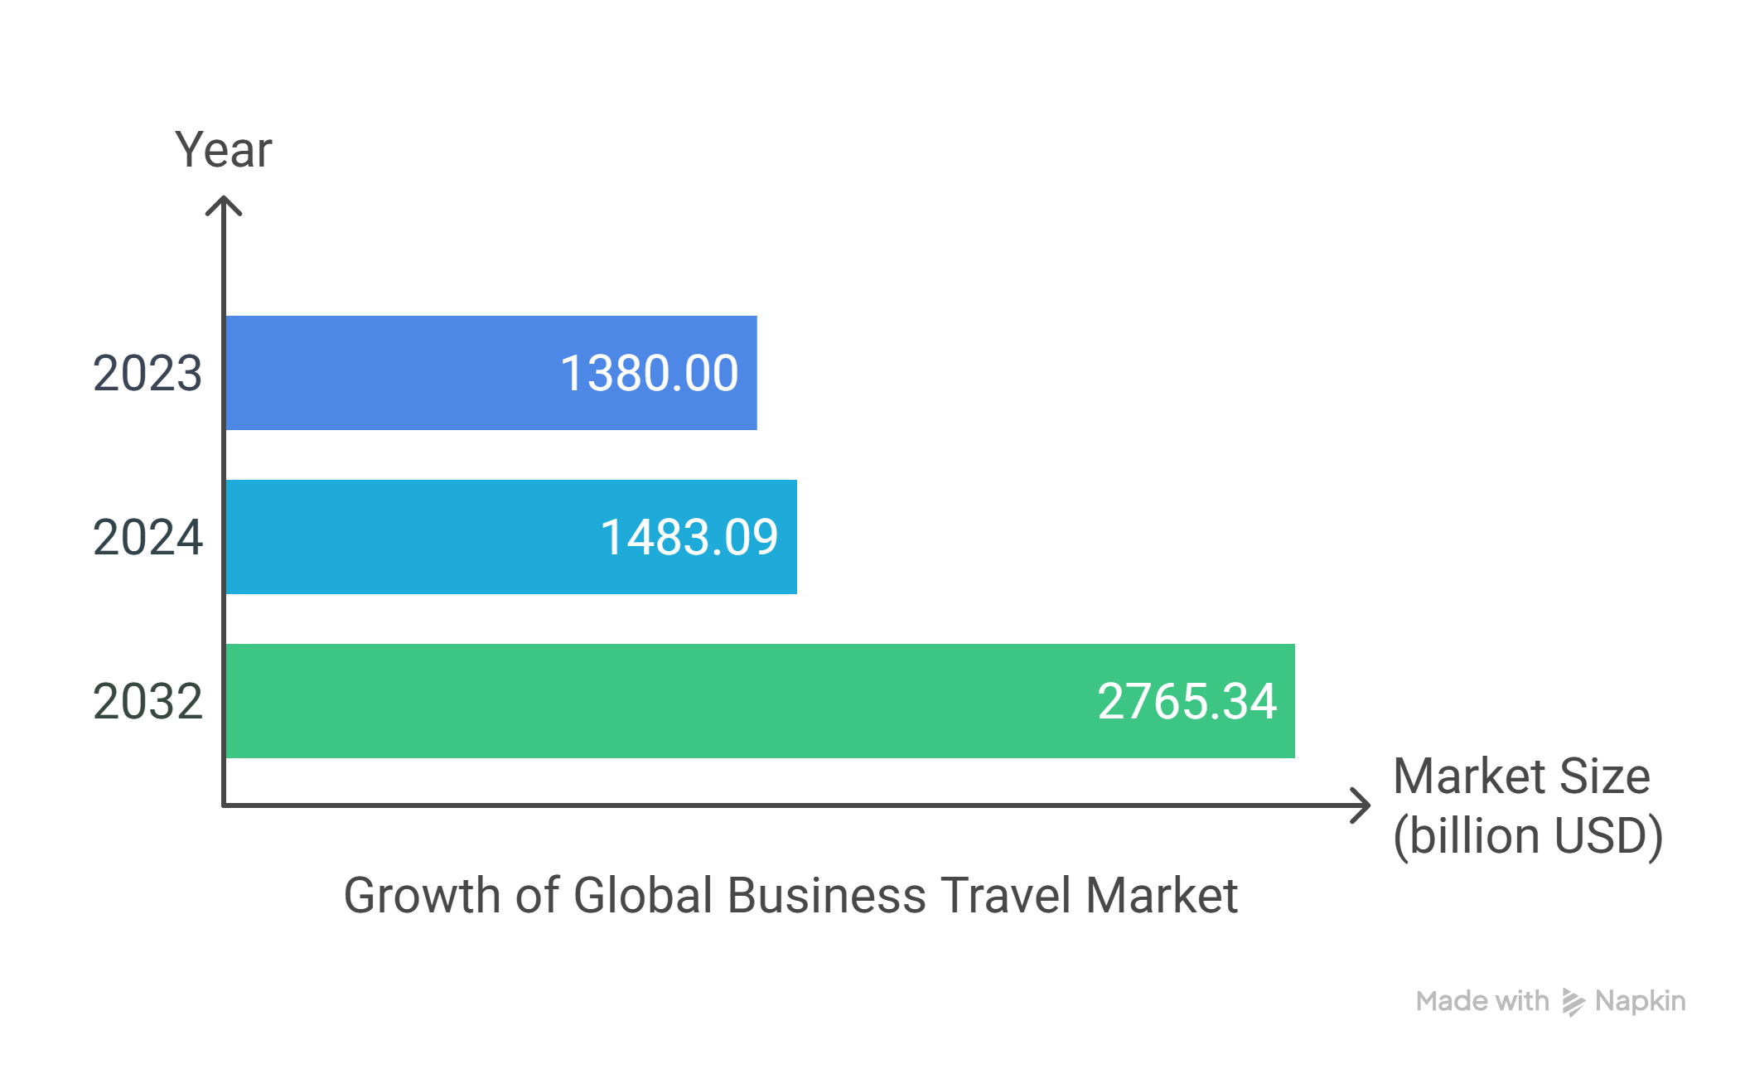
Future Opportunities

Slide 5
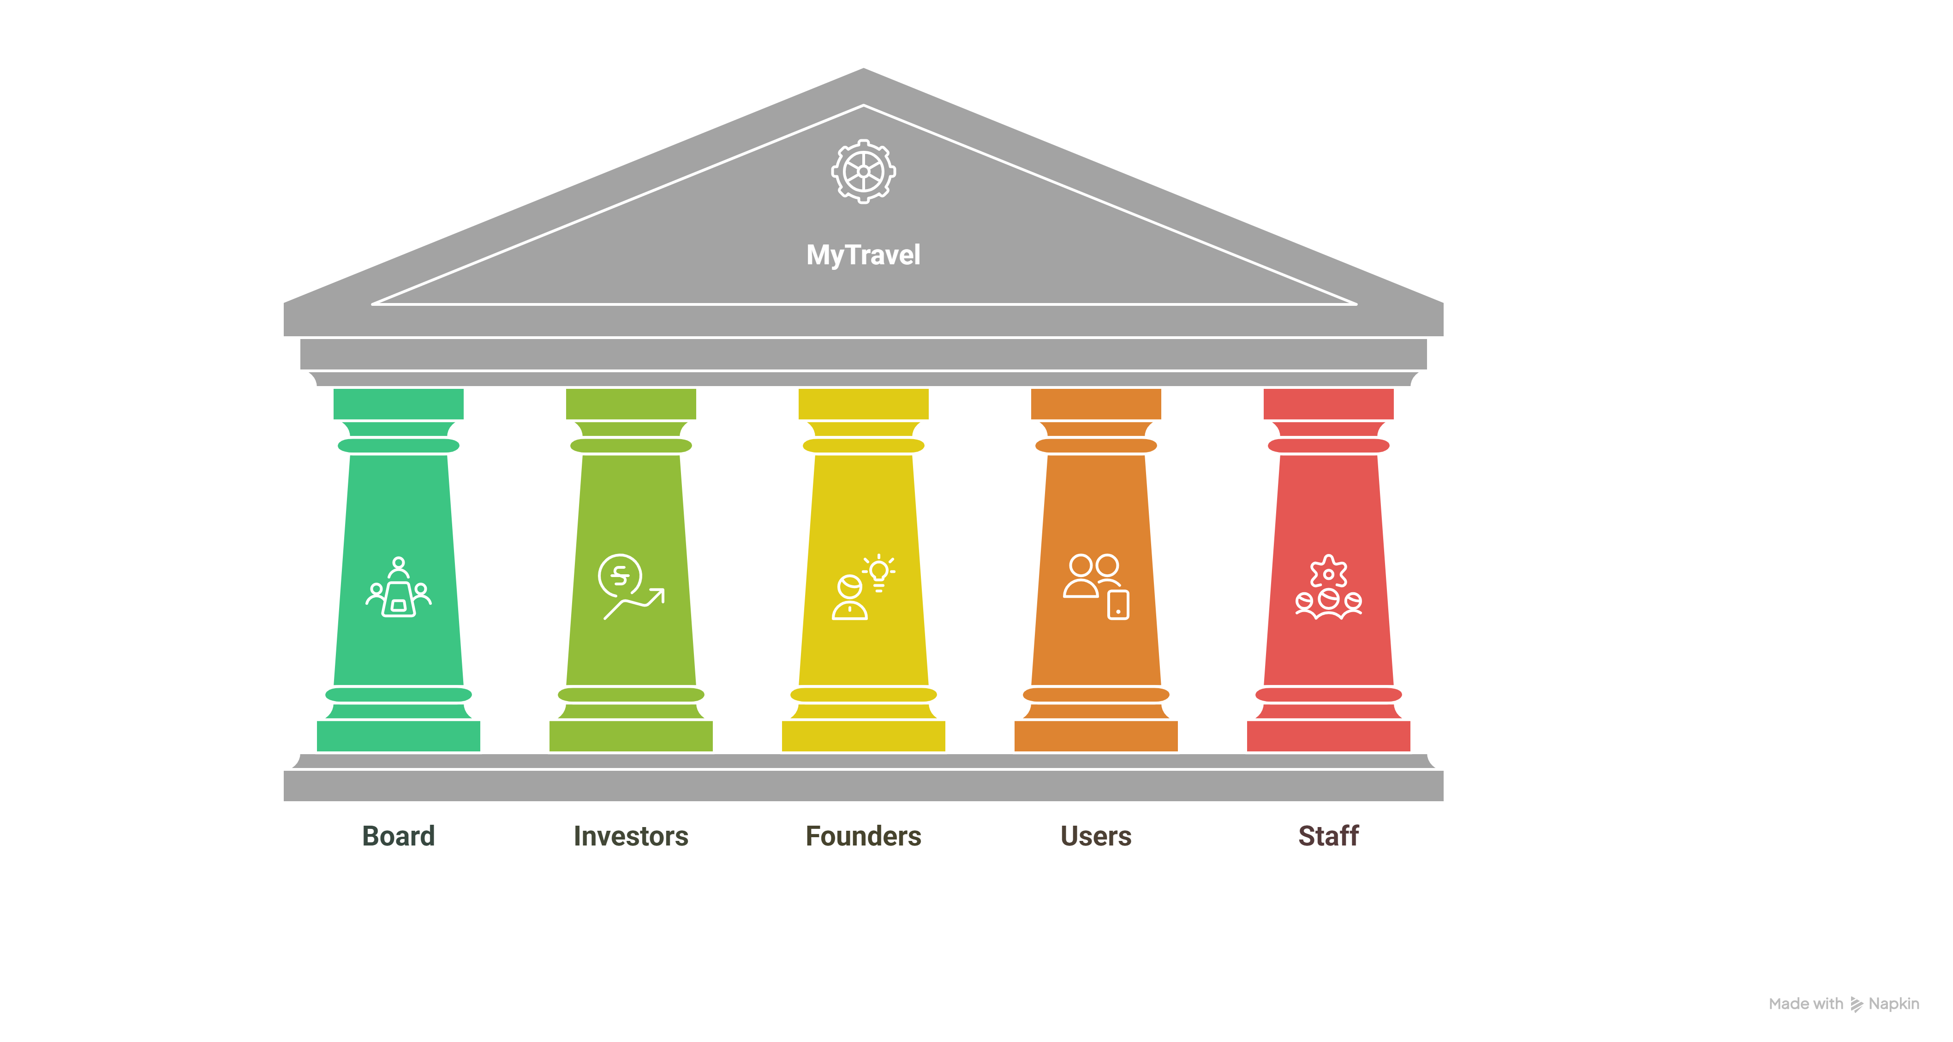
Stakeholder Landscape – “Balancing Perspectives”

Slide 6


Stakeholder Alignment – “Unifying Interests”
Investor → B2B = ROI + scalable model
Board → Clear path to profitability
Founder → Mission preserved through B2C
Users → Trust rebuilt, product improved
Staff → Role clarity, upskilling opportunities
Keep Satisfied
Corporate Investors
Corporate Partners
Manage Closely
Board of Directors
My Travel Users/ Customers
CEO
Monitor
Kickstarter Investors
Competitors
Keep Informed
Leadership Team
Staff
Influencers

Slide 7
Strategic Options – “Pathways We Explored”
B2C Focused
Option 1
B2B Focused
Option 2
Hybrid Focused
Option 3

Slide 8



Strategic Option 1 – B2C Focused
Actions
Positive Outcomes
Negative Outcomes
AI-enhanced trip planning + smart content
Booking integrations: hotel, train, insurance
Loyalty & fee-based eco subscriptions
Partner with eco-vendors, user-generated content
Green rebranding: transparency + storytelling
Rebuilds trust + brand credibility
Boosts customer experience & loyalty
Revenue via subscriptions + bookings
Aligning with original sustainability goals
High upfront cost (tech, content, marketing)
Scalability challenge vs OTA giants
Board/investor resistance
Slow ROI; brand repair takes time

Slide 9
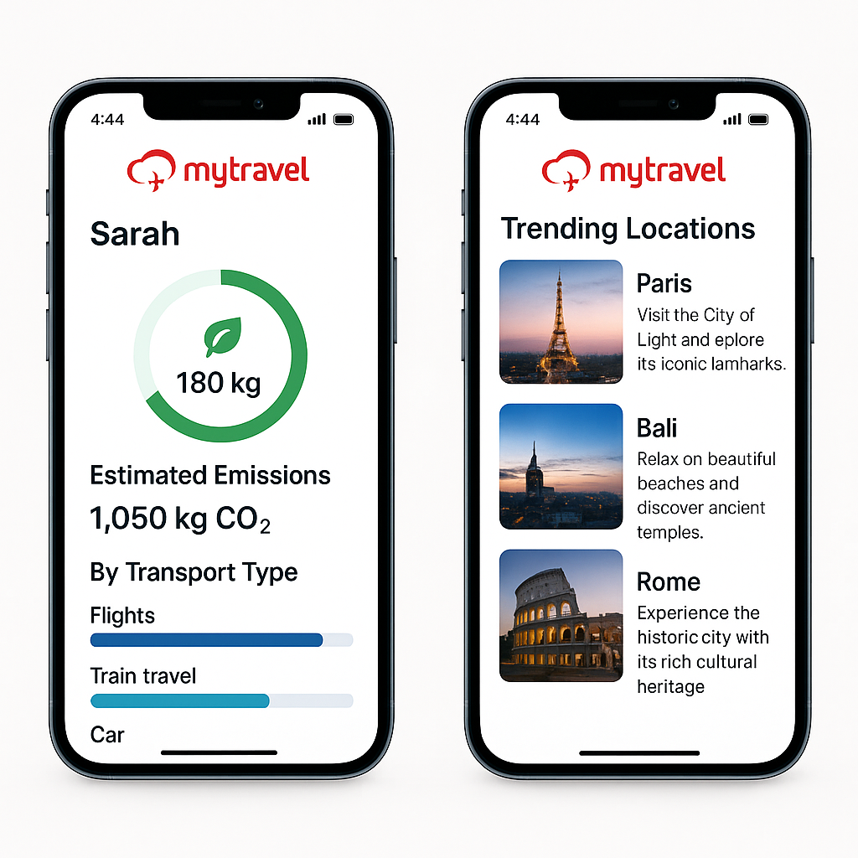
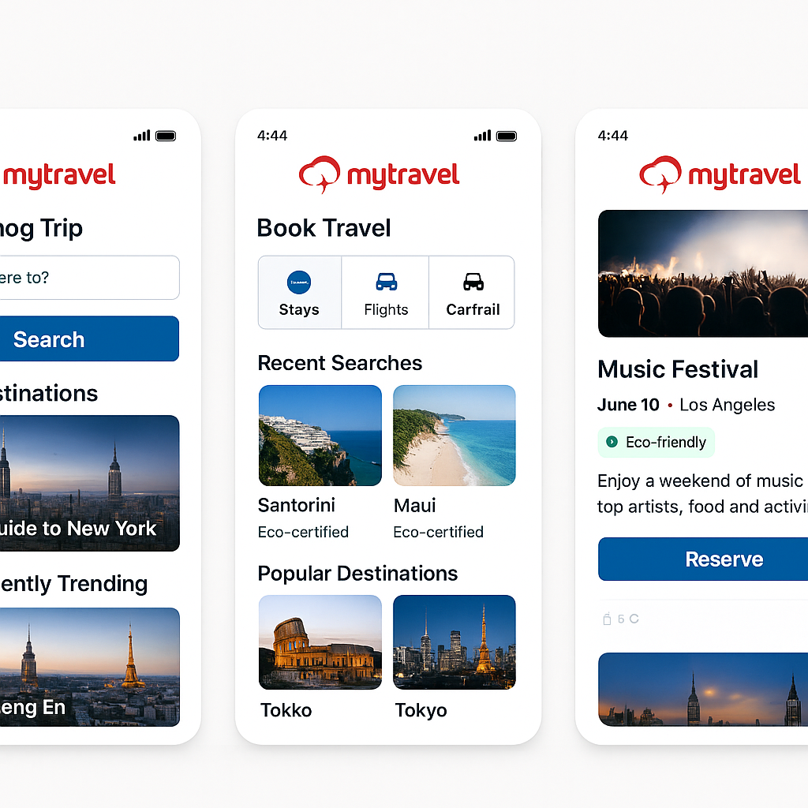

Slide 10
Strategic Option 2 – B2B Focused
Actions
Positive Outcomes
Negative Outcomes
Leveraging software infrastructure for develop SaaS platform for business travel
Pilot with investor’s network (internal + partners)
Launch enterprise carbon dashboards & reporting tools for ESG tracking
Set up enterprise sales & support functions
Phase out B2C operations to focus on B2B
Leverage proven pilot results
High-margin, scalable revenue model
Strong investor alignment
Clear ROI in short run
Adaptive cultural changes for team & founder
Requires new capabilities (enterprise sales, integrations)
Higher internal change resistance

Slide 11
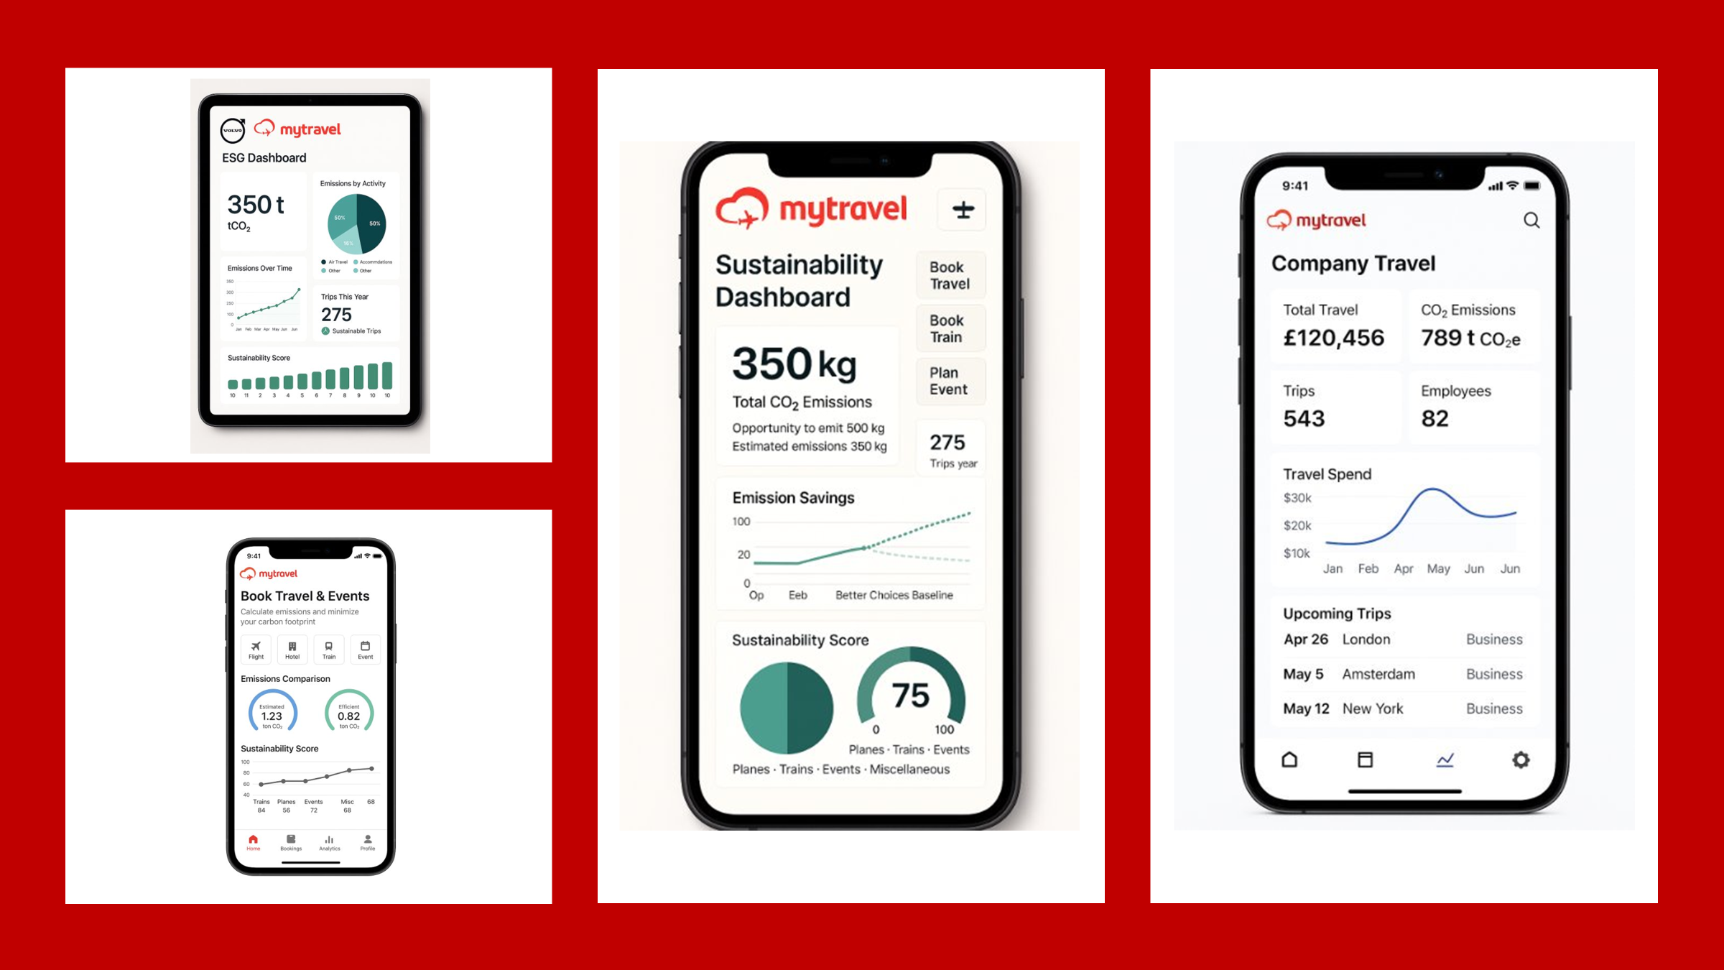

Slide 12
Strategic Choice – Hybrid Model
Actions
Positive Outcomes
Negative Outcomes
B2B + B2C
Share tech and data between both models
Rebrand around unified mission: “Sustainable Travel for All”
Phase rollout: B2B-focused investment, B2C-light presence
B2B drives scalable profit by Q4 2025
B2C protects brand identity and user trust
Stakeholder alignment across board, users, investor, founder
Balanced risk profile with diversified revenue
Complex execution: dual priorities & resource split
Needs careful alignment to avoid market confusion
Moderate initial cost before return (especially for B2B setup)

Slide 13
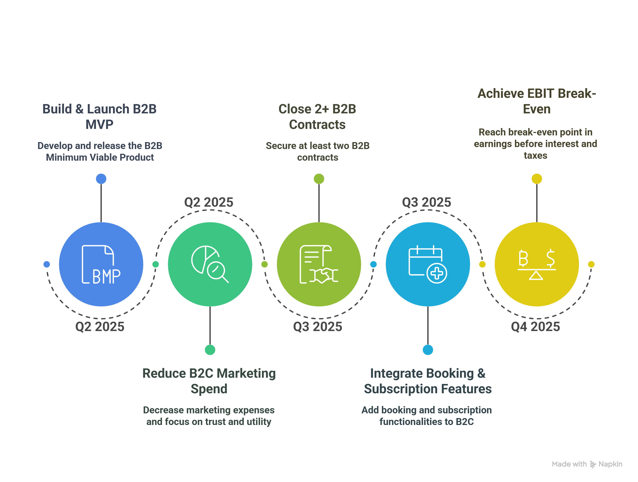
Financial Roadmap – Profit with Purpose

Slide 14
Risks & Mitigation –
“Bold Moves, Managed Risks”
Dual Model Complexity
B2B sales delays
B2C trust rebuild
Cash Runway Pressure
Phased rollout +
dedicated leads
Investor-backed pipeline, pilot-first strategy
Influencer outreach +
eco-content reform
Cost discipline +
prioritized resourcing

Slide 15

Final Recommendation – “Greenlight the Hybrid Strategy”
Our ask: Approve phased hybrid roadmap
Lead with B2B for revenue & scale
Sustain B2C to protect brand & mission
Break-even target: Q4 2025
Aligns purpose, profit & people

Slide 16
Leadership Reflection – “What This Challenge Taught Us”
Strengthened collaboration, clarity & trust
Practiced adaptive leadership under pressure
Balanced diverse stakeholder voices
Navigated tension between values & viability
Led with purpose, not ego

Slide 17

Thank
You

Slide 18
Appendix

Slide 19


Financial Roadmap – Profit with Purpose
Organization
Build & launch B2B MVP by Q2 2025
Close 2+ B2B contracts by Q3 2025
Integrate booking & subscription features into B2C
Reduce B2C marketing spend; focus on trust & utility
Achieve EBIT break-even by Q4 2025
Immediate Benefits
Risks
Revenue diversification: B2B SaaS + B2C bookings/subscription
Short-term investor satisfaction + long-term brand equity
Financial viability secured without mission compromise
B2B sales cycle could delay returns
B2C trust rebuild may take longer than expected
Runway pressure if execution is delayed

Slide 20
Financial Roadmap – Profit with Purpose
 | 2023 (actual) | 2024 (forecast) | 2025 (forecast) | 2026 (forecast)
Advertising | 20 | 5 | 30 | 60
Commissions | 192 | 300 | 600 | 1000
Revenues | 212 | 440 | 5500 | 7500
SG&A | 500 | 600 | 750 | 850
Technology Development | 2400 | 3100 | 3500 | 4000
Non-manpower | 30 | 40 | 50 | 70
Costs | 3142 | 4045 | 4930 | 5980
EBIT | -2290 | -3605 | 570 | 1520

Slide 21
Strategic Option Matrix
Option | Stakeholder Alignment (Users, Investor, Staff, Founder) | Profit Potential (by 2025) | Mission Fit (Sustainable Travel focus) | Feasibility (resources & skills) | Time to Impact (profit timeline)
1. B2C Revitalization | High for users & founder: Preserves consumer focus and brand mission (founder vision). | Low-Medium: Gradual revenue growth; unlikely to break even by Q4 2025 without a viral uptick. Long-term potential if user base surges, but short-term returns limited. | Strong: Directly aligned with original mission of sustainable consumer travel. MyTravel remains a public champion for green travel. | Low-Moderate: Requires improving tech/content – within current team’s capability – but scaling user acquisition is tough (depends on market catching on). | Slow: Little impact in next ~12 months; profitability likely beyond 2025 (current forecasts show losses through 2025file-wkeihzuoaqrywsfsx56krk).
 | Low for investor: Doesn’t address their pivot goal or immediate returns.
 | High Staff: Content team happy, but concerns about growth.
2. B2B Pivot (Enterprise SaaS) | High for investor: Meets demand for pivot and ROI, investor already advocating. | High: Each corporate client could bring significant revenue; realistic chance to hit profit by Q4 2025 with a few contracts. Scales via recurring SaaS fees. | Medium: Still promotes sustainable travel, but indirectly (through corporate policies). Might sacrifice direct consumer impact. Requires careful framing to stay true to “sustainable travel” ethos. | High: New product development needed, but we have a head start (existing app + pilot results). Sales capability is a gap. Organizational change required – doable but intense. | Medium: A minimally viable B2B product could launch by mid-2025; initial sales could yield profit by late 2025. (Execution must be swift and focused.)
 | Mid for founder: Mission reinterpreted for corporate context (may need convincing it still serves sustainability).
 | Mid Staff: Tech team energized by new challenge; some content roles may feel alienated or be reassigned.
 | Low Users: Low alignment – consumer users essentially deprioritized.
3. Hybrid (B2B + B2C) | Balanced: Tries to satisfy all parties moderately. | Medium-High: B2B side contributes to revenue (not as much as full pivot if fewer resources, but still substantial), supplemented by continued B2C commissions. Should reach break-even by Q4 2025 if execution is decent (not as explosive as full pivot, but diversified income). | High: Maintains the consumer sustainable travel mission and extends it to companies. The mission remains front-and-center in at least one part of the business. | Mid: Running dual tracks is complex for a startup. Feasibility hinges on strong project management and perhaps segmenting the team. Both initiatives must be scaled down in scope to be manageable together. | Medium: Some quick wins possible (e.g., small B2B pilots, incremental B2C revenue improvements) by 2025, but full benefits (e.g., strong brand + steady SaaS income) likely post-2025.
 | High Investor: Accepts B2B pursuit, though might worry we’re not 100% focused. Communication is Key. Highlighting that current B2B opportunities gains are benifitial in Short Term where as R&D and Development in B2C are long term gains
 | Mid Users & Founder: Reassured that B2C mission lives on, though with less emphasis.
 | Mid Staff: Most can find a role (tech on B2B, editorial refocused on core content/community). Needs careful change management to avoid confusion.

